Slide 1
CS 3006 Parallel and Distributed Computing Lecture 3
Danyal Farhat
FAST School of Computing
NUCES Lahore

Slide 2
Flynn’s Classical Taxonomy and Processor to Memory Connection Strategies

Slide 3
Outline
Flynn’s Classical Taxonomy
Processor Organizations
SISD
SISD – Multithreading
Implicit Multithreading
Explicit Multithreading
Intel’s Hyper Threading Technology
SIMD
SIMD - Examples

Slide 4
Outline
MISD
MIMD
MIMD - Shared Memory
Uniform Memory Access (UMA)
Non-Uniform Memory Access (NUMA)
MIMD - Distributed Memory
Shared Memory Interconnection Network
Summary

Slide 5
Flynn’s Classical Taxonomy
Hardware architecture classifications – Flynn, Feng, Handler
Most widely used parallel computer classifications
Differentiates multiprocessor computers according to the dimensions of instruction and data
Instruction stream: Sequence of instructions from memory to control unit
Data stream: Sequence of data from memory to control unit
SISD: Single Instruction stream, Single Data stream
SIMD: Single Instruction stream, Multiple Data stream
MISD: Multiple Instruction stream, Single Data stream
MIMD: Multiple Instruction stream, Multiple Data stream

Slide 6
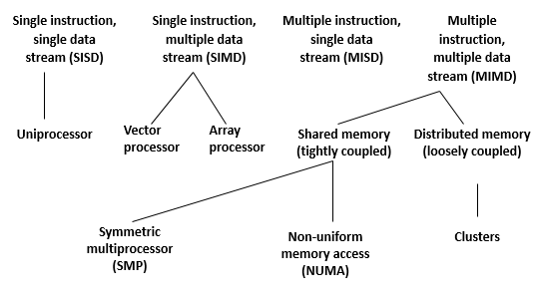
Processor Organizations

Slide 7
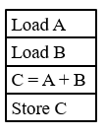
SISD
A serial (non-parallel computer)
Single instruction: one instruction per cycle
Single data: only one data stream per cycle
Easy and deterministic execution
Example:
Single CPU workstations
Most workstations from HP, IBM and SGI are SISD machines

Slide 8
SISD (Cont.)
Performance of a processor can be measured with:
MIPS Rate = f x IPC
Million instructions per second (MIPS) is an approximate measure of a computer's raw processing power
f (clock frequency of processor); IPC (instructions per cycle)
How to increase performance of uniprocessor?
Using Multithreading
Increasing clock frequency
Increasing number of instructions completed during a processor cycle (multiple pipelines in a superscalar architecture and/or out of order execution)

Slide 9
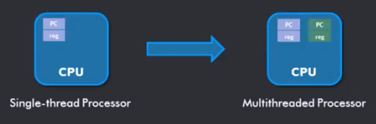
SISD – Multithreading
Run multiple threads on the same core concurrently
Context switch implemented in hardware
Minimum hardware support: replicate architectural state
All running threads must have their own context
Multiple register sets in the core
Multiple state registers
Program Counter (PC)
Memory Address Register (MAR)
Accumulator Register (ACC)

Slide 10
SISD – Multithreading (Cont.)
Implicit Multithreading
concurrent execution of multiple threads extracted from a single sequential program
Managed by processor hardware
Improve individual application performance
Explicit Multithreading
concurrent execution of instructions from different explicit threads, either by interleaving instructions from different threads or by parallel execution on parallel pipelines

Slide 11
SISD-Explicit Multithreading
Four approaches for explicit multithreading
Interleaved multithreading (fine-grained): fetch instructions from different threads in consecutive cycles. In case of few active threads, performance degrades
Blocked multithreading (coarse-grained): events like cache miss produce switch
Simultaneous multithreading (SMT): execution units of a superscalar processor receive instructions from multiple threads
Chip multiprocessing: e.g. dual core (not SISD)
Architectures like IA-64 Very Long Instruction Word (VLIW) allow multiple instructions (to be executed in parallel) in a single word

Slide 12
Intel’s Hyper Threading Technology
A single physical processor appears as two logical processors by applying two-threaded SMT approach
Example: Intel Pentium 4 in 2002
Each logical processor maintains a complete set of architecture state (general-purpose registers, control registers,…)
Logical processors share nearly all other resources such as caches, execution units, branch predictors, control logic and buses

Slide 13
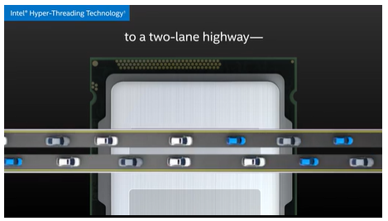
Intel’s Hyper Threading Technology (Cont.)
Partitioned resources are recombined when only one thread is active
Add less than 5% to the relative chip size
Improve performance by 16% to 28%

Slide 14
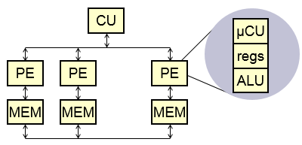
SIMD
Homogeneous processing units / processing elements (PEs)
Single instruction: All processor units execute the same instruction at any given time
Multiple data: Each processing unit can operate on different data set
Example: Add A and B, C and D, X and Z

Slide 15
SIMD (Cont.)
Each processing element has an associated data memory
So that each instruction is executed on a different set of data by the different processors
Used by vector and array processors
Suitable for vector and matrix calculations
Vector processors act on array of similar data (only when executing in vector mode) and in this case they are several times faster than when executing in scalar mode
Example: NEC SX-8 processors run at 2 GHz for vectors and 1 GHz for scalar operations

Slide 16
SIMD - Examples
A good example is the processing of pixels on screen
A sequential processor would examine each pixel one at a time and apply the processing instruction
An array or vector processor can process all the elements of an array simultaneously
Game consoles and graphic cards make heavy use of such processors to shift those pixels
Such designs are usually dedicated to a particular application and not commonly marketed for general purpose computing

Slide 17
SIMD-Examples (Cont.) – Super Mario

Slide 18
MISD
A single data stream is transmitted to a set of processors, each of which executes a different instruction sequence
Each processing unit operates on the data independently via independent instruction stream
This structure is not commercially implemented
Example: Multiple cryptography algorithms attempting to crack a coded message

Slide 19
MIMD
Multiple instruction: Every processor may execute a different instruction stream
Multiple data: Every processor may work with a different data stream
Examples:
Most of the current supercomputers
Grid computers
Networked parallel computers
Symmetric Multiprocessors (SMP) computers

Slide 20
MIMD (Cont.)
MIMD systems are mainly:
Shared Memory (SM) Systems:
Multiple CPUs share same address space
There is only one memory
Distributed Memory (DM) Systems:
Each CPU has its own associated memory
CPUs are connected by some network (clusters)

Slide 21
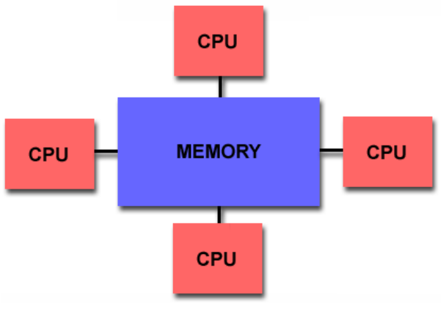
MIMD - Shared Memory
All processors have access to all memory as a global address space

Slide 22
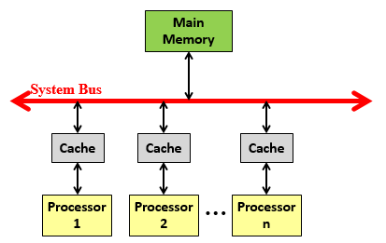
Uniform Memory Access (UMA)
From all processing units to the shared memory, the data access time is constant.
Mostly represented by Symmetric Multiprocessor (SMP) machines.

Slide 23
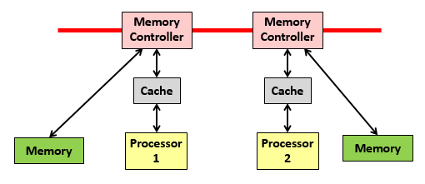
Non-Uniform Memory Access (NUMA)
From all processing units to the shared memory, the data access time is not constant.

Slide 24
Shared Memory Interconnection Network
Main problem is how to do interconnections of the CPUs to each other and to the memory
There are three main network topologies available:
Crossbar (n x n connections - datapath without sharing)
Ω-network(n log2 n connections - log2 n switching stages and shared on a path)
Central databus (O(1) connections - n shared)

Slide 25
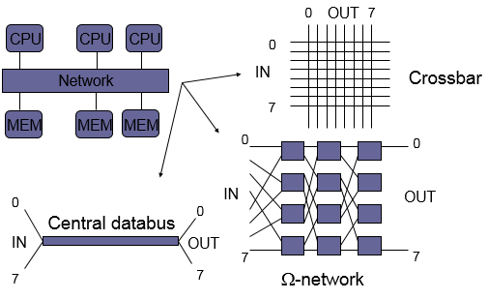
Shared Memory Interconnection Network (Cont.)

Slide 26
Summary
Flynn’s Classical Taxonomy
Differentiates multiprocessor computers on the basis of dimensions of instruction and data
Processor Organizations
SISD - Used in uniprocessor computers
SIMD - Used in vector or array processor computers
MISD - Not commercially implemented
MIMD - Used in supercomputers, grid computers etc.

Slide 27
Summary (Cont.)
SISD
Easy and deterministic but with limited performance
SISD processor performance - MIPS Rate = f x IPC
How to increase performance of uniprocessor?
SISD – Multithreading
Implicit Multithreading - Implemented at compiler or OS kernel level
Explicit Multithreading - Defined be the programmer
Interleaved multithreading
Blocked multithreading
Simultaneous multithreading

Slide 28
Summary (Cont.)
Intel’s Hyper Threading Technology
Single physical processor appears as two logical processors by applying two-threaded SMT approach (Used in Pentium 4 PCs - 2002)
SIMD
Homogeneous processing units (vector or array processors)
Execution of single instruction on multiple data sets using single control unit
Associated data memory for each processing element
SIMD – Examples
Processing of pixels, online gaming servers, matrix based calculations etc.

Slide 29
Summary (Cont.)
MISD
Single data stream transmitted to a set of processors, each of which executes a different instruction sequence
Commercially not implemented
Example: Multiple cryptography algorithms attempting to crack a coded message
MIMD
Supercomputers, Grid computers, Networked parallel computers etc.

Slide 30
Summary (Cont.)
MIMD - Shared Memory - CPUs share same address space
Uniform Memory Access (UMA) - Constant data access time
Non-Uniform Memory Access (NUMA) - Non-Constant data access time
MIMD - Distributed Memory
CPUs connected via network and have their own associated memory
Shared Memory Interconnection Network
Crossbar - n x n connections, no path sharing
Omega Network - n log n connections, shared path
Bus - O (1) connections, shared path

Slide 31
Questions?

